Slide 1

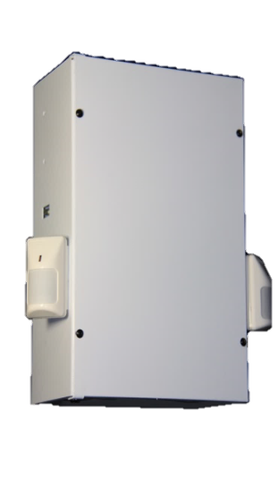
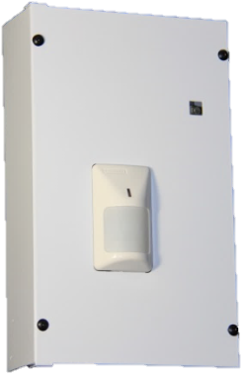
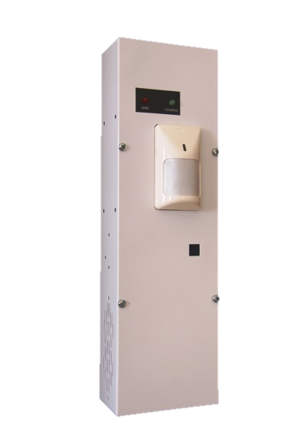
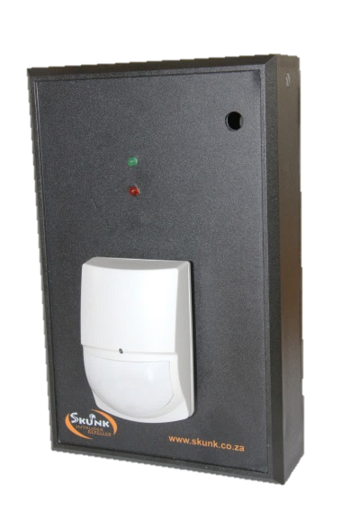
082 447 9544
086 007 5865
sales@skunk.co.za
www.skunk.co.za
Skunk Distrubutors
Pepper Spray Alarm systems
Master Unit
Mini Industrial Unit
Features
• Stand alone pepper spray alarm or
connect to existing alarm system
• SMS Communicating (optional Extra)
• Solar charger input
• 1 x 7AH Battery
• Battery Back Up approximately 5 days standby
• Remote or key switch arming/disarming
• Code hopping remote controlls
• Panic button (can be remote or hardwired)
• Activation warning (Delayed activation Can be done)
• 1 x 425ml Canister
• Approximately 6 sprays of 5 seconds each per 425ml canister
• 1 x Passive
• Steel Box
Features
• Stand alone pepper spray alarm or
connect to existing alarm system
• SMS Communicating (optional Extra)
• Solar charger input
• 1 x 7AH Battery
• Battery Back Up approximately 5 days standby
• Remote or key switch arming/disarming
• Code hopping remote controlls
• Panic button (can be remote or hardwired)
• Activation warning (Delayed activation Can be done)
• 2 x 425ml Canister
• Approximately 6 sprays of 5 seconds each per 425ml canister
• 2 x Passive
• Steel Box
Entry Level Unit
Baby Skunk Unit
Features
• Stand-alone pepper spray alarm system or
connect to existing alarm system
• SMS Communicating (optional extra)
• Remote or key switch arming/disarming
• Code hopping remote controls
• Extra strength pepper spray (15% Capsicum)
• Totally natural pepper spray
• 1 x 225ml Pepper spray canister
• Solar charger input
• 1 x 1.3AH Battery
• 24 Hours battery back up
• 1 x Passive
• Steel Box
Features
• Stand-alone pepper spray alarm system or
connect to existing alarm system
• SMS Communicating (optional extra)
• Remote or key switch arming/disarming
• Code hopping remote controls
• Extra strength pepper spray (15% Capsicum)
• Totally natural pepper spray
• 1 x 225ml Pepper spray canister
• 1 x 1.3AH Battery
• 24 Hours battery back up
• 1 x Passive
• Plastic Box

